Slide 1
Introduction to RDBMS

Slide 2
RDBMS
What is Data?
What is Database?
What is DBMS?
What is RDBMS?

Slide 3
RAM 20 60 70 AB 99
Data represents unorganized and unprocessed facts.
Data represents unorganized and unprocessed facts.

Slide 4
What is Database?
A database is a collection of information that is organized so that it can easily be accessed, managed, and updated.
In one view, databases can be classified according to types of content

Slide 5
What is DBMS?
A database management system (DBMS) is a collection of programs that enables you to store, modify, and extract information from a database.

Slide 6
Relational Database
A relational database is a set of tables containing data fitted into predefined categories.
Each table contains one or more data categories in columns.
Each row contains a unique instance of data for the categories defined by the columns.

Slide 7
Relational Database
The relational database was invented by E. F. Codd at IBM in 1970.

Slide 8
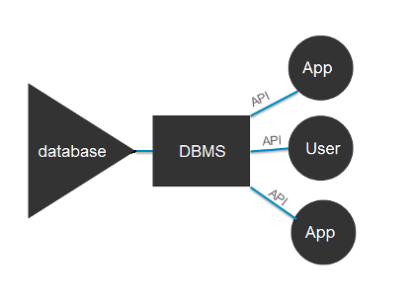

Slide 9
Advantages of RDBMS
Data abstraction and independence
Data security
A locking mechanism for concurrent access
Robust data integrity capabilities
Logging and auditing of activity
Simple access using a standard application programming interface (API)
Backup and recovery

